Slide 1


Cairo University Faculty of Engineering
Computer Engineering Department
Graduation Project
Ahmed Ayman Ahmad
Ammar Mohamd Sobhi
Mohamed Akram Abdelfattah
Omar Ahmed Mohamed
Supervised by:
Prof. Hoda Baraka

Slide 2

Table of contents
04 System Modules
01 Introduction
05 Results and Verification
02 Literature & Market Survey
03 System Architecture
06 Conclusions and Future work

Slide 3
01 Introduction
Introduction
Problem Definition & Motivation
Solution

Slide 4
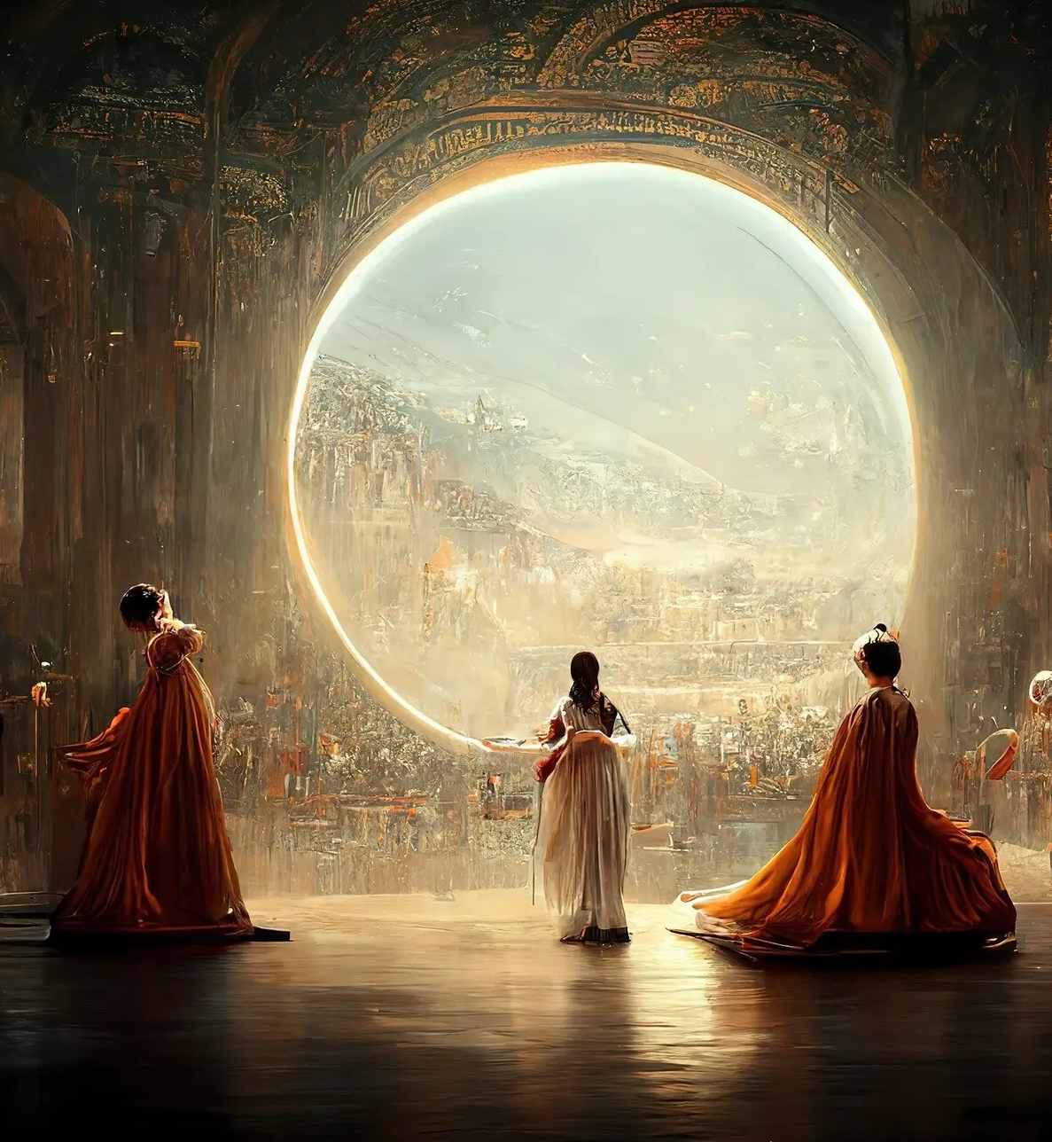
Introduction
We live in the era of generative AI.
Huge progress in Deep Learning and GAN made it possible to generate Text, Pictures, Videos, Music or prize-winning Art.
Can we differentiate between reality and falsity?

Slide 5
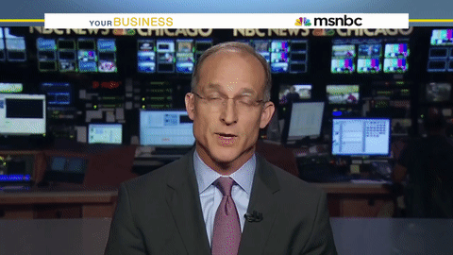
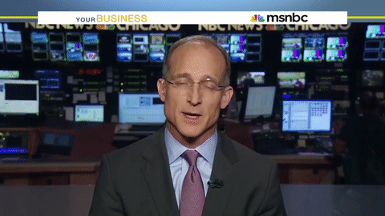

Only one of those is real, can you spot it?

Slide 6
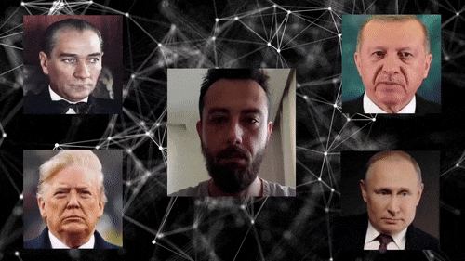
Problem Definition
Generating realistic fake content became easy.
Face Manipulation techniques have advanced as well where you can swap the face of a person in a video or replace his expressions.

Slide 7

Motivation
Fake videos can be used in fake news, politics, adult content, blackmailing, financial fraud and more.
Many people are now afraid from just sharing their picture on the internet.
Detecting and fighting spread of fake content became so important.

Slide 8
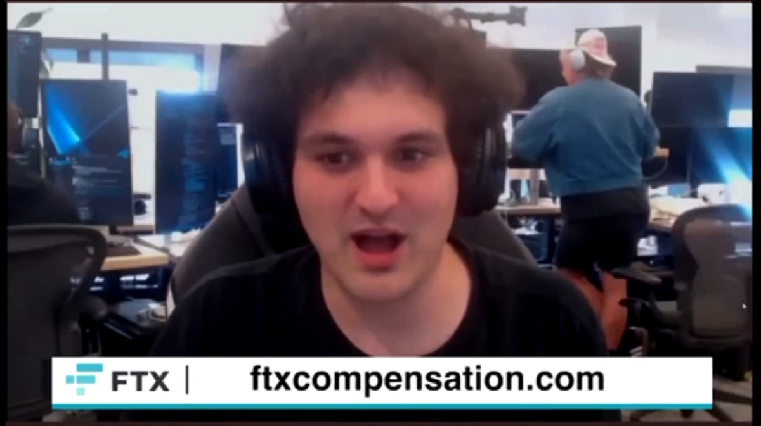
Motivation
Real world examples:
Zelenskyy’s fake video calling on the military to lay down their arms.
FTX founder offers compensation that double your cryptocurrency.
Suicides over blackmail in Egypt.

Slide 9
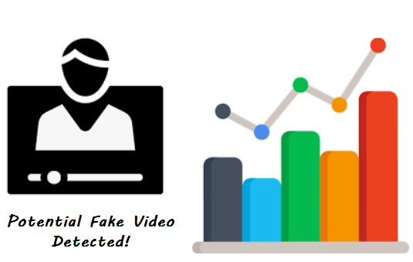
Solution
Revelio is a system built to analyze and detect possibly manipulated videos.
Our system can detect and analyze various manipulation types whether it is face swap or expression swap.
We use four different analysis methods to make our system resilient to different manipulations.

Slide 10
02 Literature & Markey Survey
Background
Literature Survey
Market Survey

Slide 11
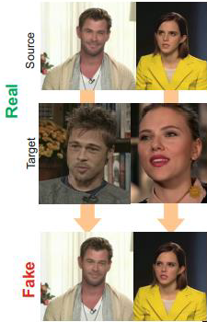
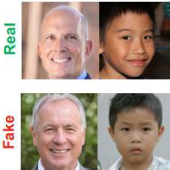
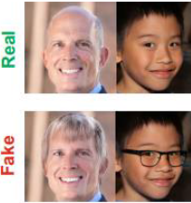
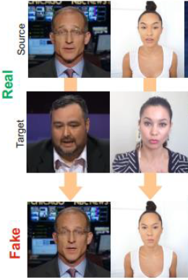
Background
Types of facial manipulations.
Entire Face Synthesis
Attribute Manipulation
Identity Swap
Expression Swap

Slide 12
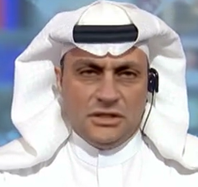
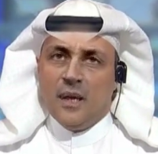
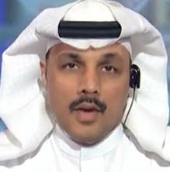
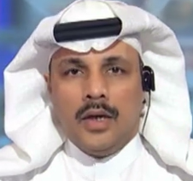
Background
FaceForensics++ Dataset
DeepFakes
FaceSwap
Face2Face
NeuralTextures

Slide 13
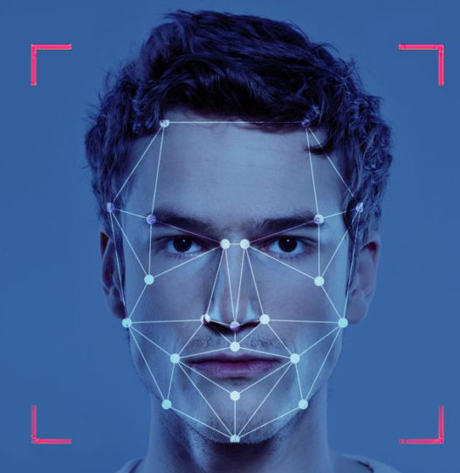
Literature Survey
DeepFake appeared in late 2017.
Media Forensics research became dedicated to fight it.
DeepFake Detection research grown massively in the last 5 years.
Methods used based on past biometric anti-spoofing research and recent data-driven deep learning.

Slide 14
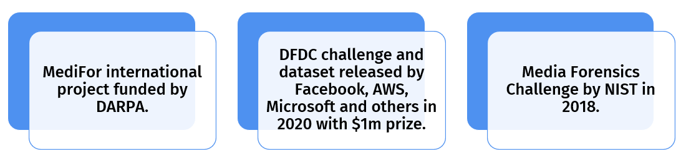
Literature Survey

Slide 15


Market Survey
Competitors:

Slide 16

03 System Architecture
Introduction
Problem Definition & Motivation
Solution

Slide 17
System Architecture
Our main approach is to use multiple analysis techniques to make our system more resilient.
Each technique will be able to detect certain artifacts and product its own analysis.

Slide 18
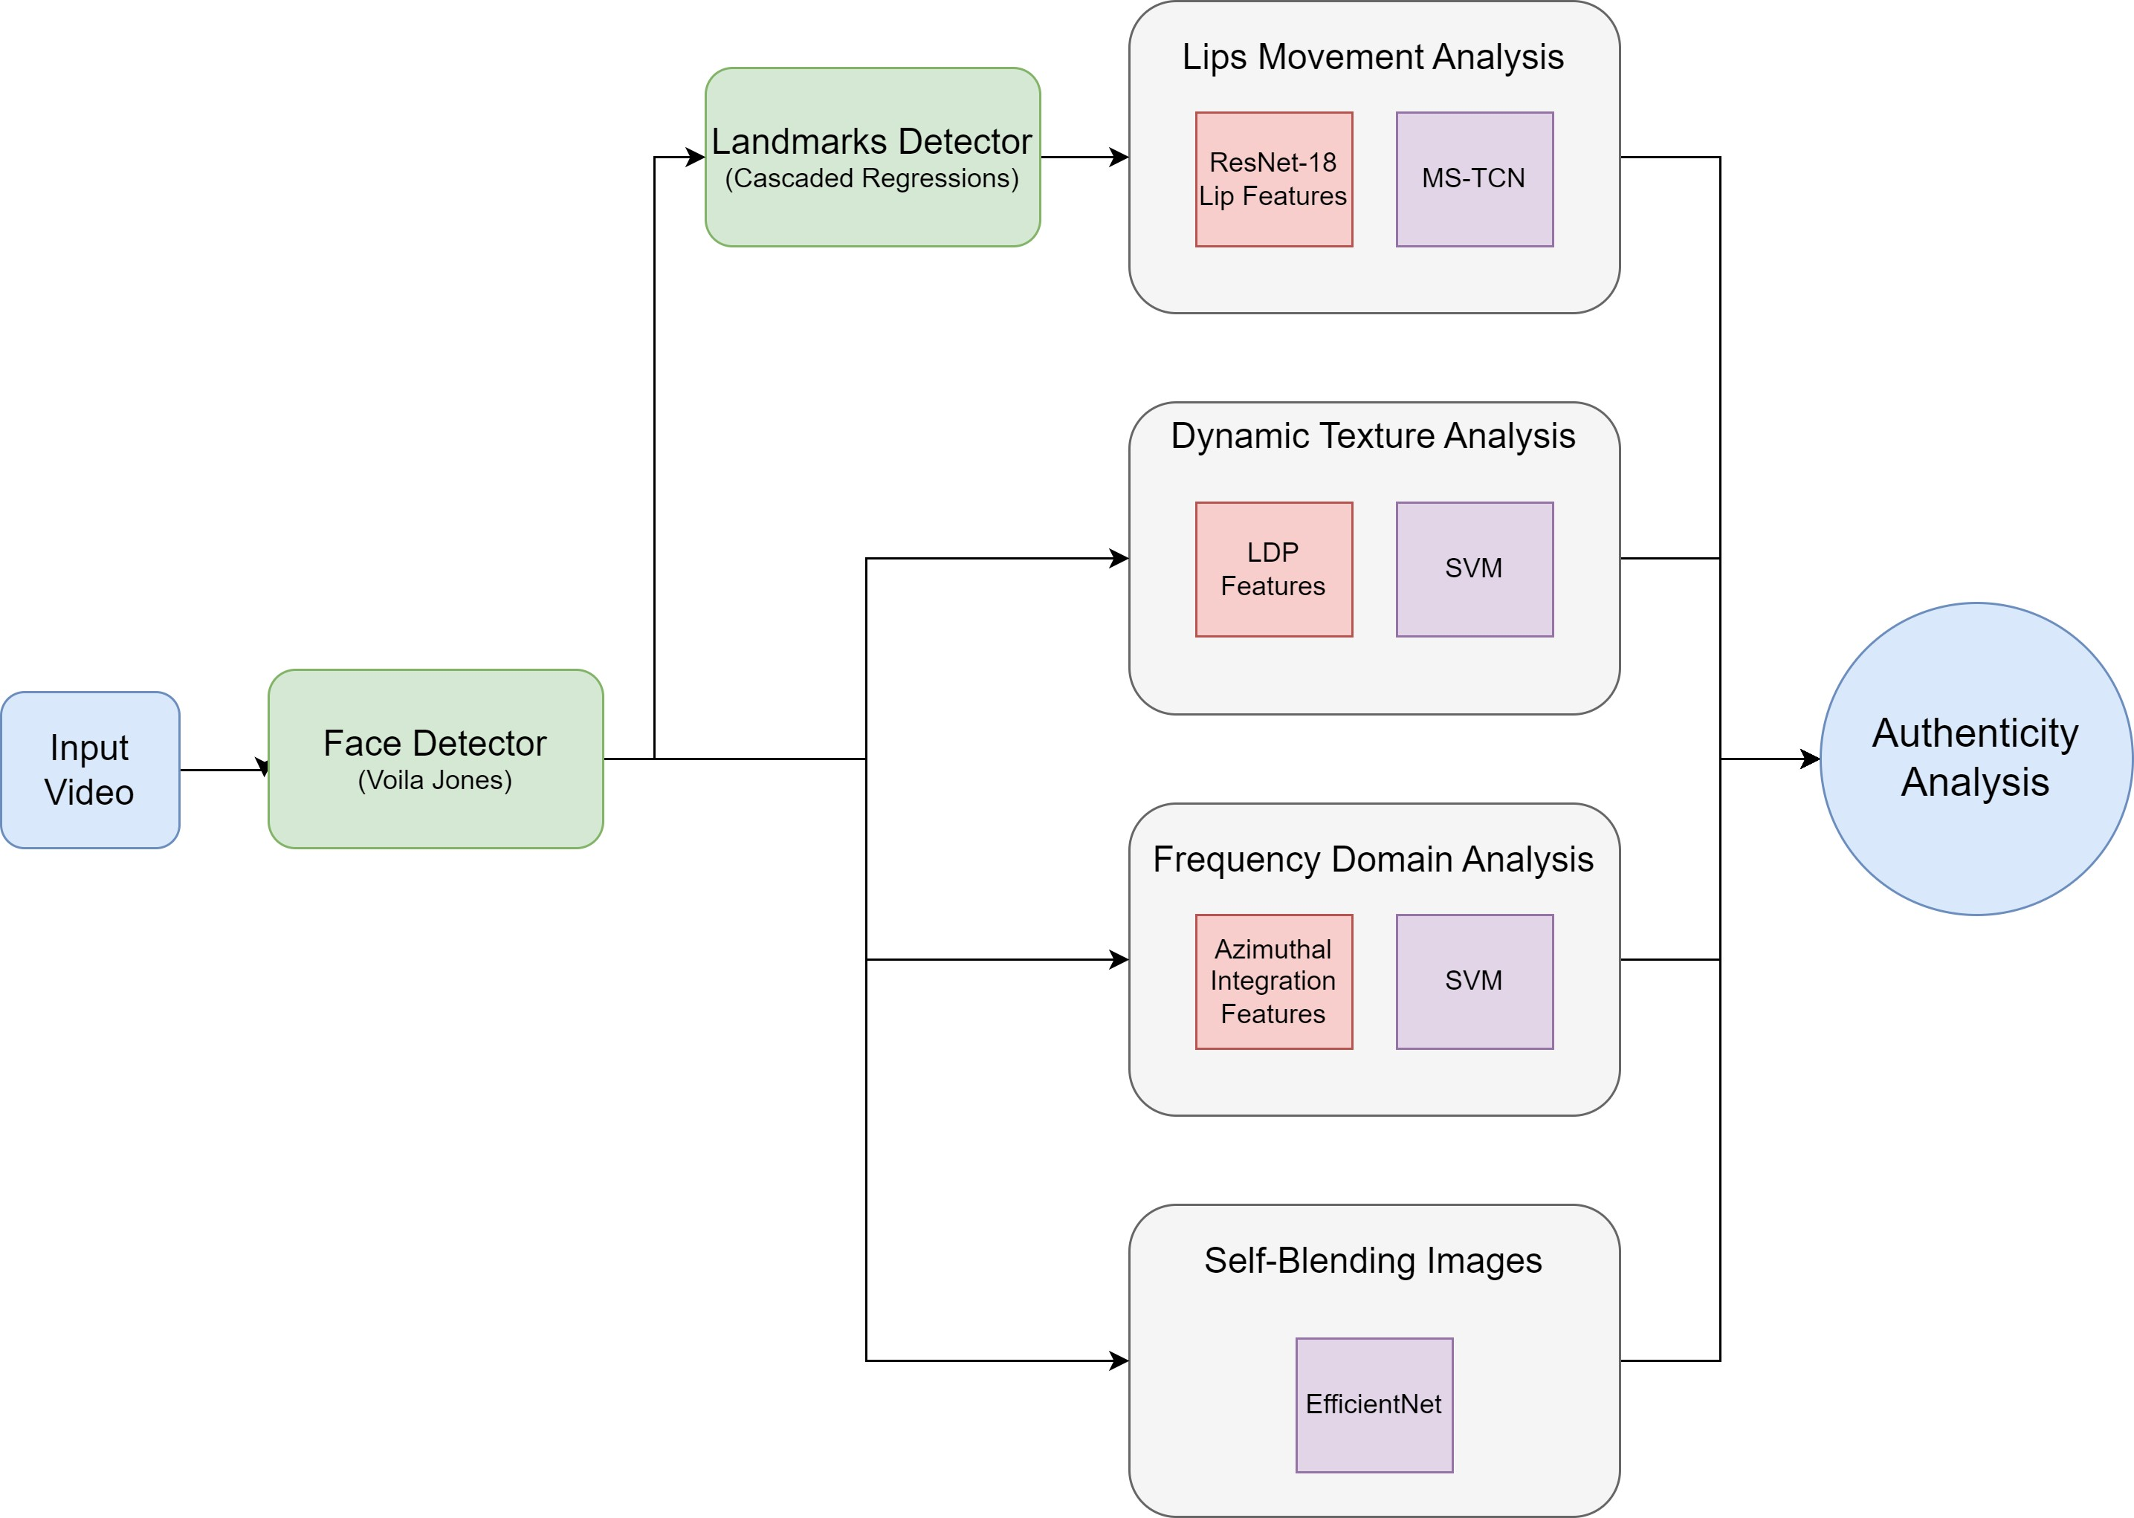
Block Diagram

Slide 19






04 System Modules
Face Detection
Facial Landmarks Detection
Lips Movement Analysis
Dynamic Texture Analysis
Frequency Domain Analysis
Self-Blended Images

Slide 20
Face Detection

Slide 21
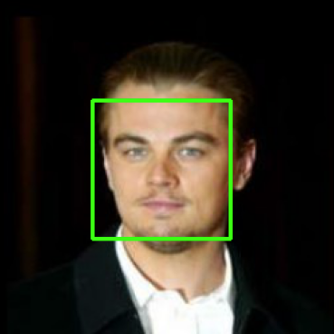
Face Detection
Our focus is manipulations made to faces (not entire images)
Thus, we need face detection
Used method is based on the Viola-Jones algorithm

Slide 22
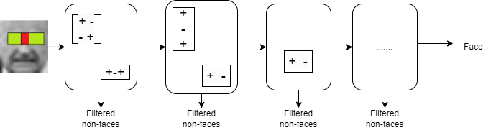

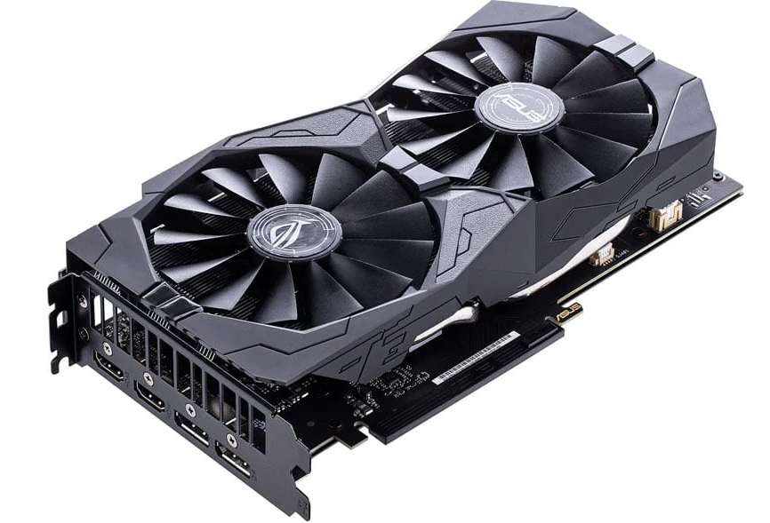
Face Detection - Algorithm
Notes:
Viola-Jones uses a cascade of boosted classifiers
These classifiers are built using simple features
It takes time for training; thus, training was implemented on GPU using PyTorch
Number of features for a 24x24 image is above 162,000 feature.

Slide 23

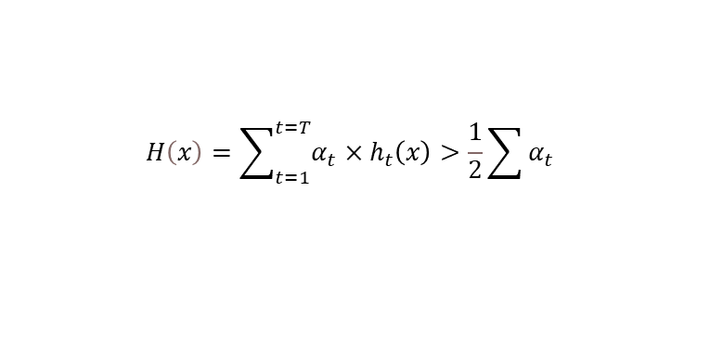
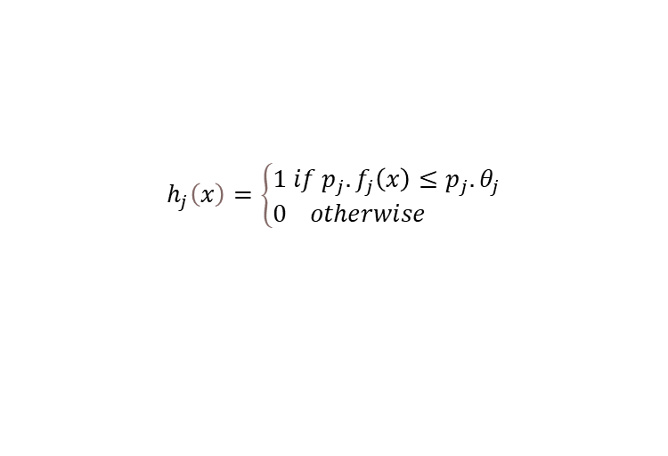
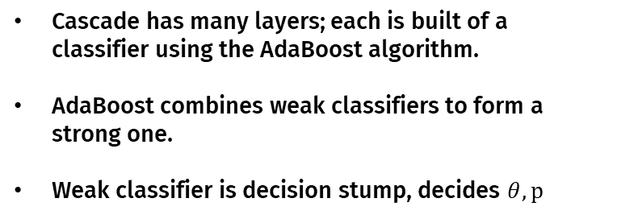
Face Detection - Algorithm
Cascade has many layers; each is built of a classifier using the AdaBoost algorithm.
AdaBoost combines weak classifiers to form a strong one.
Weak classifier is decision stump, decides $θ, p$
$$h_{j}\left(x\right)=\left\{\begin{aligned}&1 if p_{j}.f_{j}\left(x\right)≤p_{j}.θ_{j} \\ &0 otherwise \end{aligned}\right.$$
$$H\left(x\right)=\sum_{t=1}^{t=T}{α_{t}×h_{t}\left(x\right)}>\frac{1}{2}\sum{α_{t}}$$

Slide 24
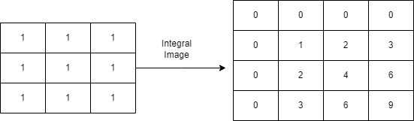
Face Detection – Feature Extraction
Calculate the integral image for faster area calculation
Use indices to calculate rectangle area for multiple images (faster calculation)

Slide 25
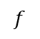
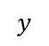
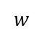
Face Detection – Decision Stump
$$f$$
0.25 | 0.5 | 0.25
0.25 | 0.5 | 0.25
0.25 | 0.5 | 0.25
0.25 | 0.5 | 0.25
0.25 | 0.5 | 0.25
0.5 | 0.25 | 0.25
$$w$$
$$y$$
Notes:
Features are put in a matrix of shape $n_{features}×n_{samples}$
Each sample has a weight (importance)
Error is $∑w_{i}×I\left(y_{i}≠y_{pred}\right)$
To find $θ, p$with minimum error:
• $Sort features,weights, labels by feature value$
• $For some polarity:find accumulative sum of weights$
$from left, right, sum them$
• $Find examples that gives minimum error$
• $Find feature that gives minimum error across all features$
- This made training 8.5 times faster than Python’s sklearn, can be better on better machines.

Slide 26
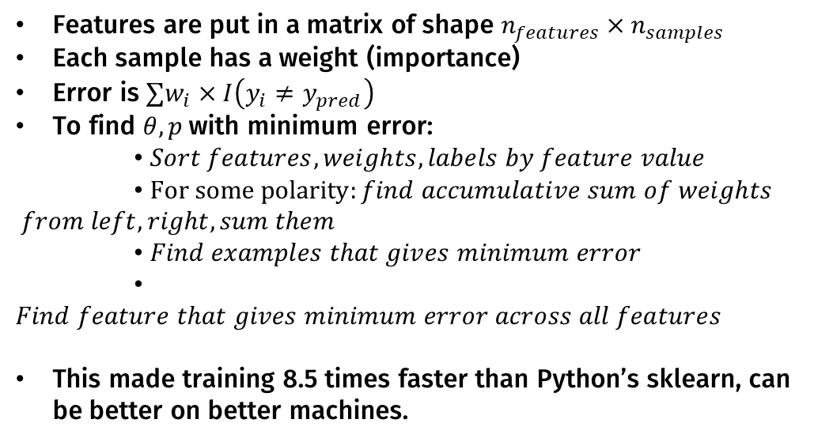
Face Detection – Decision Stump
Features are put in a matrix of shape $n_{features}×n_{samples}$
Each sample has a weight (importance)
Error is $∑w_{i}×I\left(y_{i}≠y_{pred}\right)$
To find $θ, p$with minimum error:
• $Sort features,weights, labels by feature value$
• $For some polarity:find accumulative sum of weights$
$$from left, right, sum them$$
• $Find examples that gives minimum error$
• $Find feature that gives minimum error across all features$
This made training 8.5 times faster than Python’s sklearn, can be better on better machines.

Slide 27
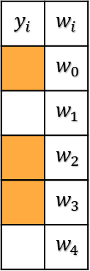
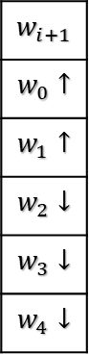
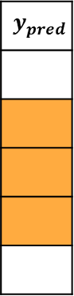
Face Detection – AdaBoost
An iterative algorithm
The method updates the weights for each example
This update focuses on harder examples in each iteration
$$y_{i}$$ | $$w_{i}$$
 | $$w_{0}$$
 | $$w_{1}$$
 | $$w_{2}$$
 | $$w_{3}$$
 | $$w_{4}$$
$$y_{pred}$$
$$w_{i+1}$$
$$w_{0}↑$$
$$w_{1}↑$$
$$w_{2}↓$$
$$w_{3}↓$$
$$w_{4}↓$$
predict
update
Notes:
An iterative algorithm
The method updates the weights for each example
This update focuses on harder examples in each iteration

Slide 28
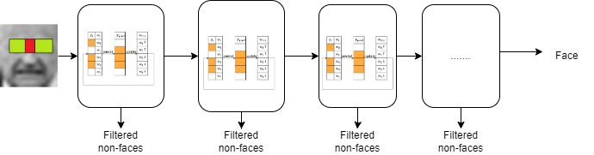
Face Detection – Cascade
Different layers of boosted classifiers form a cascaded classifier.
Trains on different negatives to minimize false positives.
Images classified as nonfaces don’t propagate later layers, making it faster

Slide 29

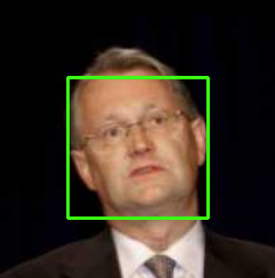

Face Detection – Results
Inference is done by classifying sub-windows as faces or non-faces
Training Accuracy
Testing Accuracy
One layer of 200 features

Slide 30
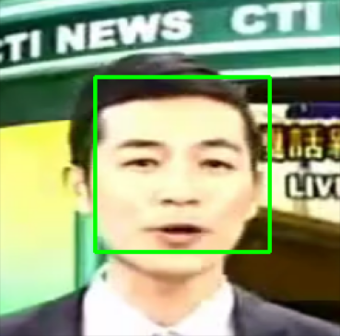
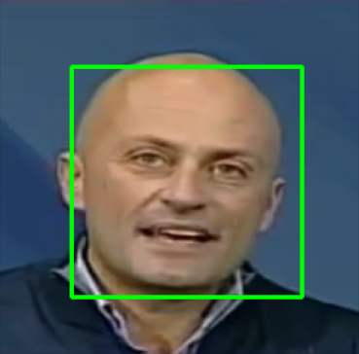
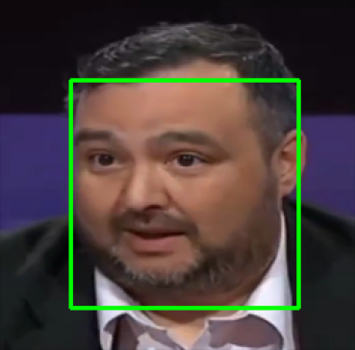
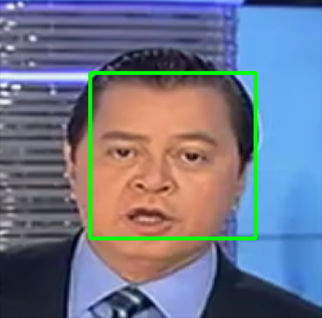
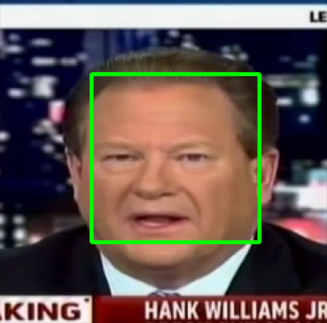
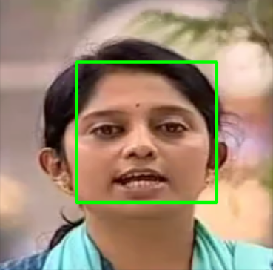
Face Detection – Results

Slide 31
Face Detection – Limitations
It is sensitive to background images; empty backgrounds are easier to classify
Background images used for training affect the final model greatly. So, they should be close to the area of usage.

Slide 32
Facial Landmarks Detection

Slide 33
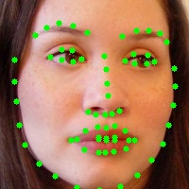
Facial Landmarks Detector
Facial Landmarks Detection is so popular in Computer Vision and has so many applications.
We use it in our system to crop aligned mouth regions for Lips Movement Analysis.

Slide 34

Facial Landmarks Detector
Facial Landmarks Detection Methods
Holistic Methods
Constrained Local Methods
Regression Based Methods
Direct Regression
Cascaded Regression
Deep Learning Based

Slide 35
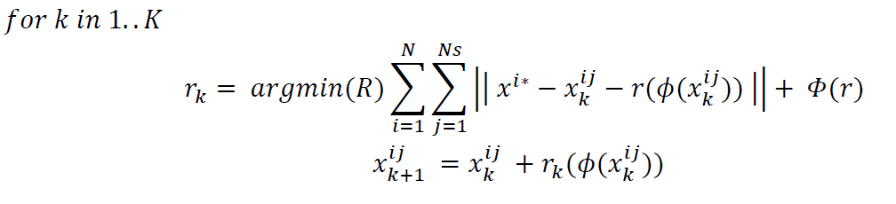
Facial Landmarks Detector
Coarse-To-Fine Shape Searching Algorithm.
Training Regressors

Slide 36
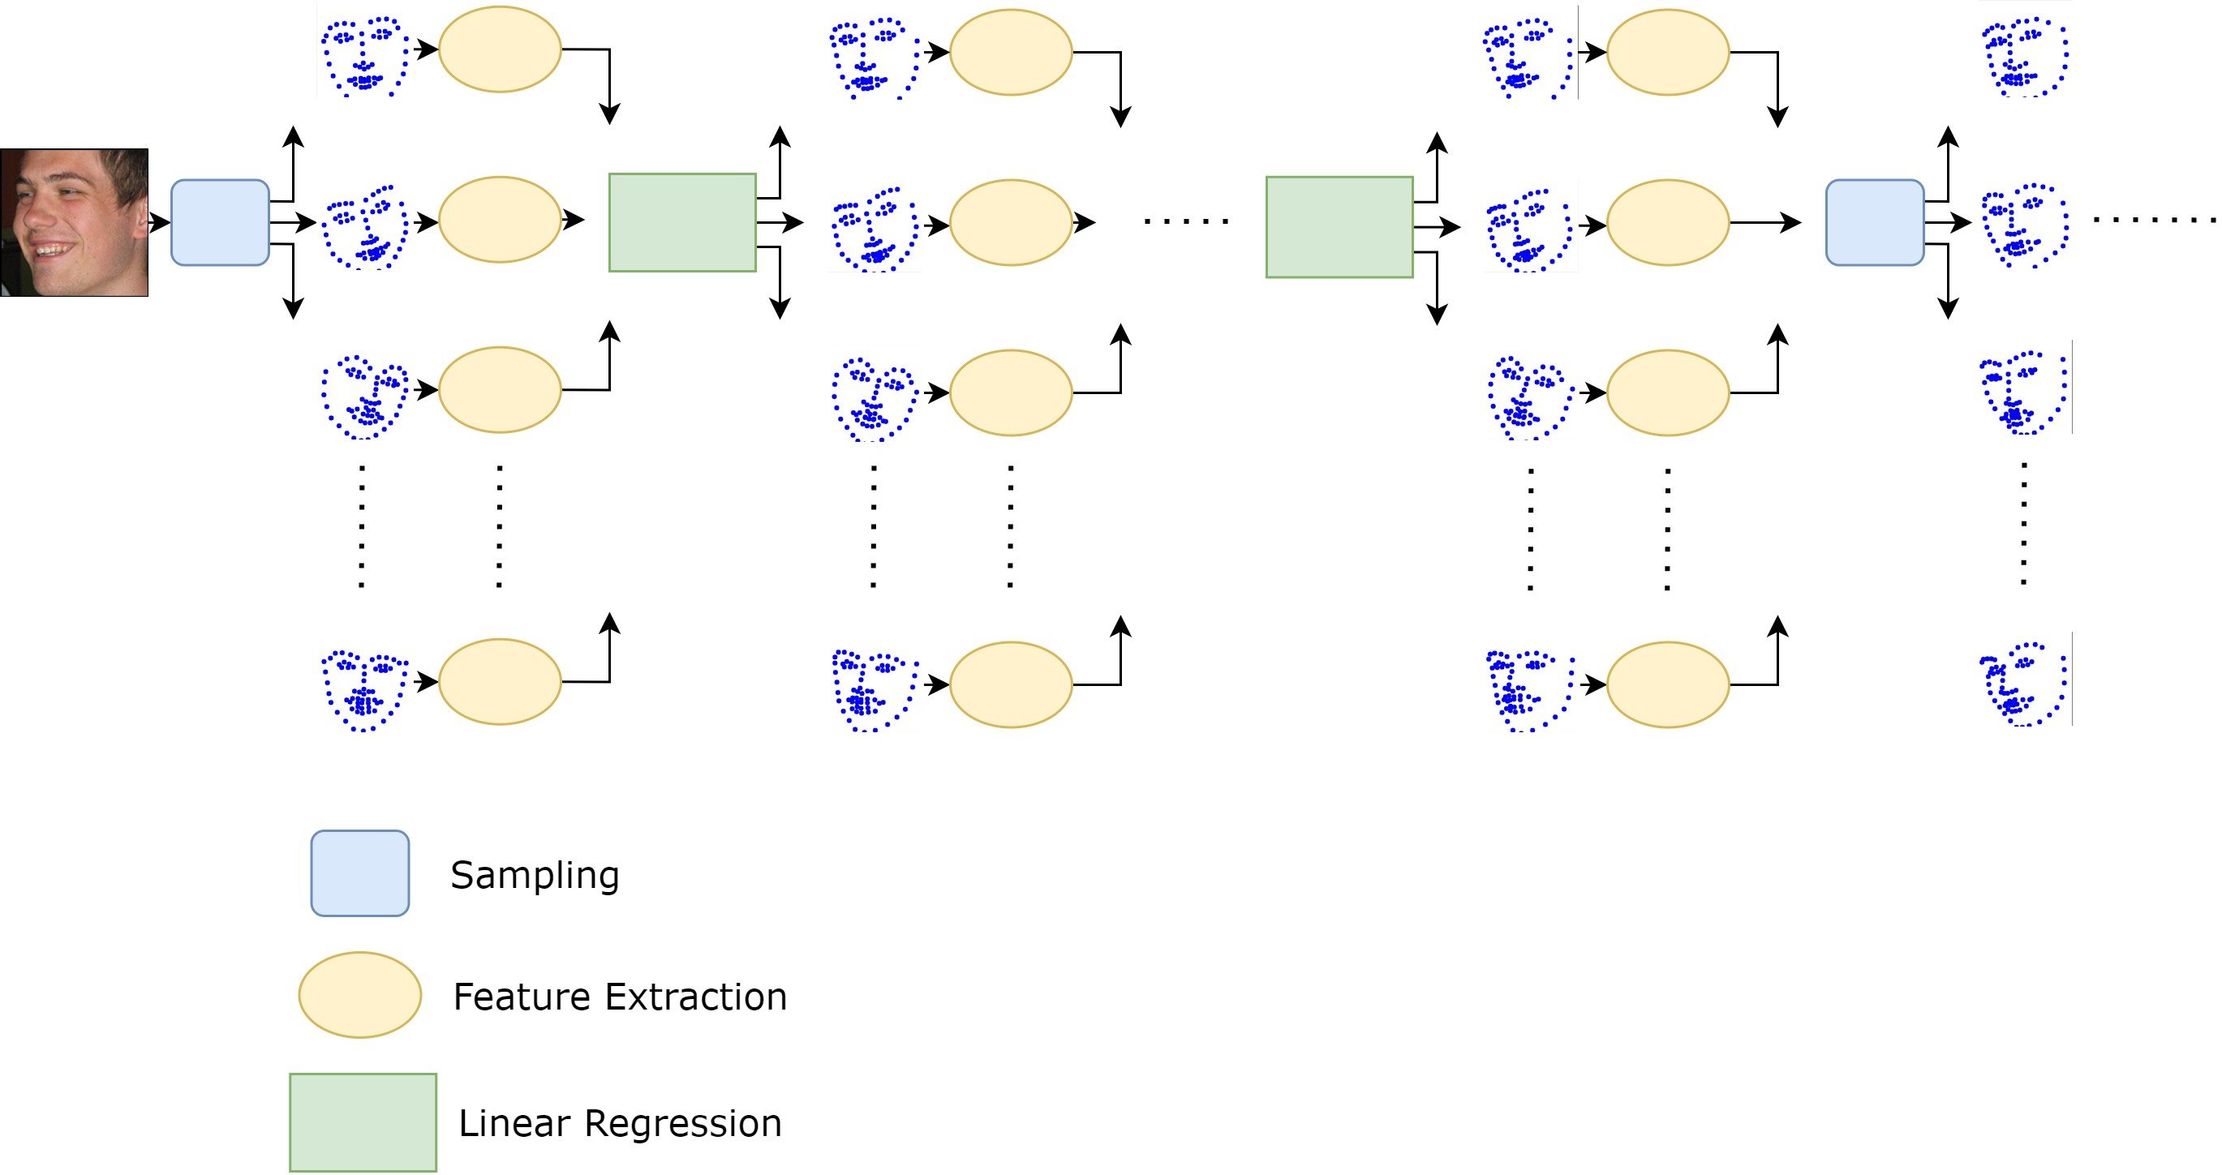
Facial Landmarks Detector
Coarse-To-Fine Shape Searching Algorithm.

Slide 37

Facial Landmarks Detector
Coarse-To-Fine Shape Searching Algorithm.
Feature Extraction
Different feature descriptors can be used.
Our final model used HOG and SIFT.
HOG was used in early stages and SIFT in the last stage.

Slide 38
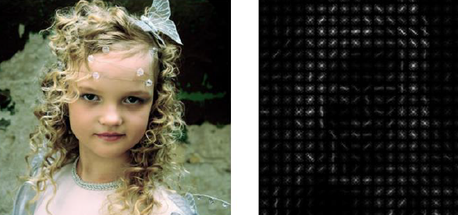
Facial Landmarks Detector
Coarse-To-Fine Shape Searching Algorithm.
Histogram of Oriented Gradients
Compute Gradient Image.
Compute Histogram of Gradients for each cell.
Normalize Histogram over blocks.
Normalized Histograms are concatenated.

Slide 39

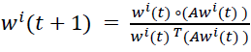
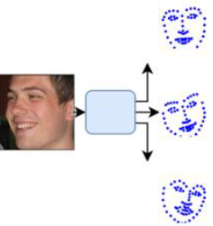
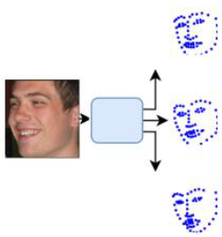
Facial Landmarks Detector
Coarse-To-Fine Shape Searching Algorithm.
Updating Distributions
Calculate Affinity Matrices using similarity function.
Update weights for regressed samples using replicator dynamics.
Calculate weighted average of regressed samples.
Update probability distribution with gaussian similarity between mean shape and candidate shapes.

Slide 40
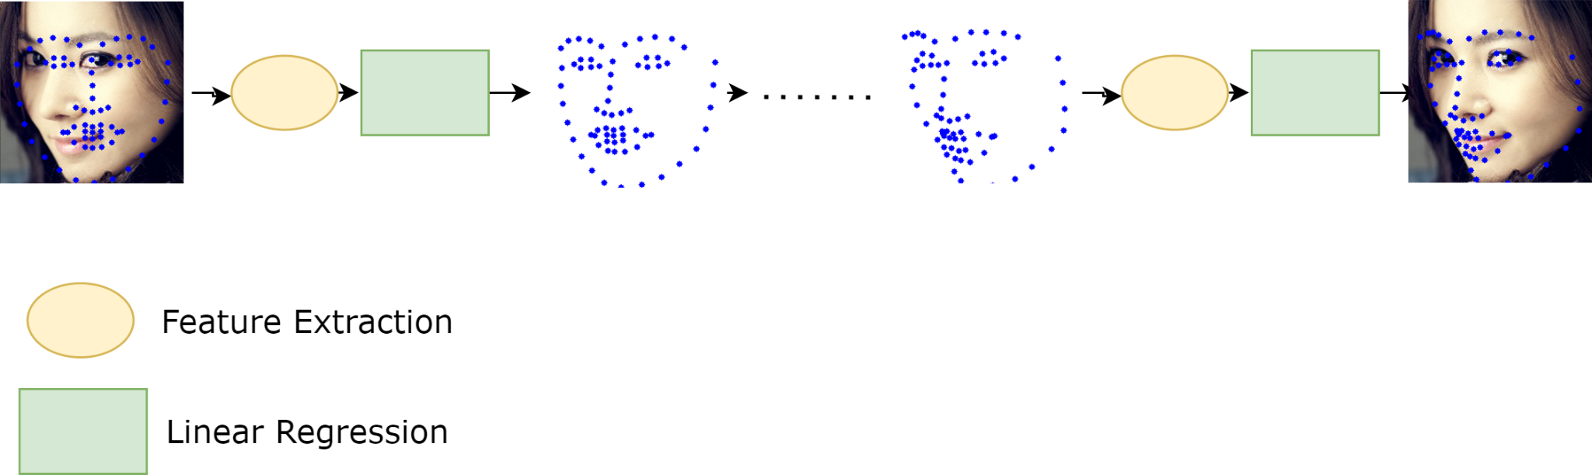
Facial Landmarks Detector
Coarse-To-Fine Shape Searching Algorithm.
Inference

Slide 41
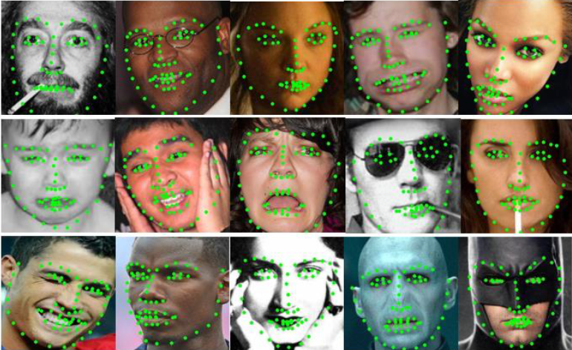
Facial Landmarks Detector
Coarse-To-Fine Shape Searching Algorithm.
Results
Helen |  |  | LFPW
Method | Type | Error | Method | Type | Error
FPLL [19] | C | 8.16 | FPLL | C | 8.29
DRMF [21] | C | 6.70 | DRMF | C | 6.57
Revelio | R | 6.38 | RCPR | R | 6.56
RCPR [22] | R | 5.93 | Revelio | R | 6.15
CFAN [23] | DR | 5.53 | CFAN | DR | 5.44
Original CFSS [14] | R | 4.63 | Original CFSS | R | 4.87

Slide 42
Now it is time to analyze!

Slide 43
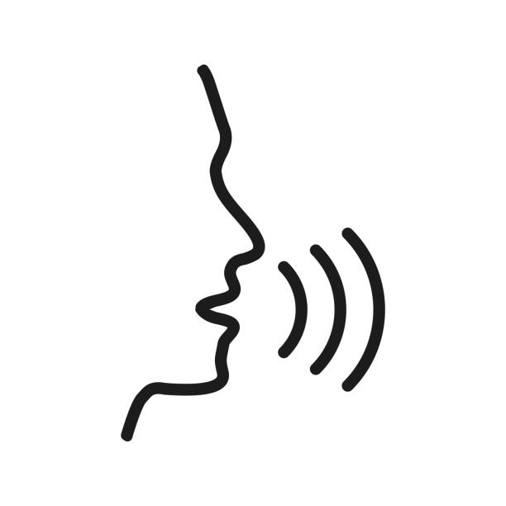
Lips Movement Analysis
Lips Natural Movement is very delicate.
Some irregularities can be noticed with fake videos.
Detection methods can take advantage of this.
Models pretrained on Lip Reading are very sensitive to capture and describe mouth movements.

Slide 44
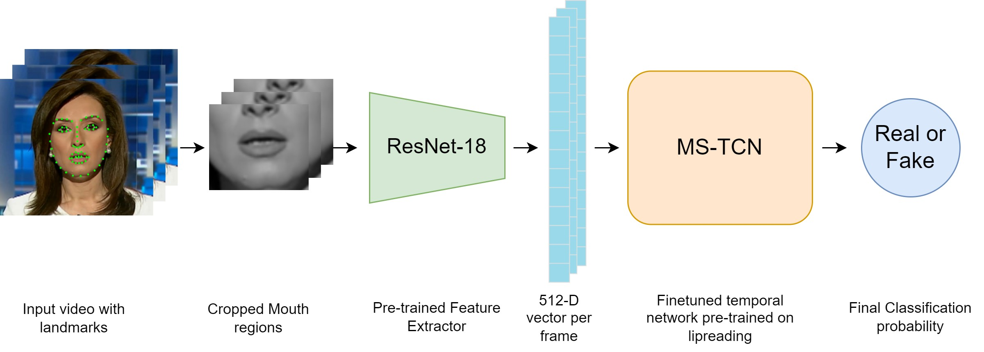
Lips Movement Analysis

Slide 45

Lips Movement Analysis

Slide 46
Lips Movement Analysis
Metric | DF (HQ) |  | FS (HQ) |  | NT (HQ) |  | F2F (HQ) |  | Average
Accuracy % (Video-level) | 92.5 |  | 99.3 |  | 92.1 |  | 97.9 |  | 95.45
AUC % (Video-level) | 97.7 |  | 100 |  | 98.3 |  | 99.7 |  | 98.9
Confusion Matrix (Video-level) | 124 | 16 | 139 | 1 | 131 | 9 | 139 | 1
 | 5 | 135 | 1 | 139 | 13 | 127 | 5 | 136

Slide 47
Dynamic Texture Analysis
Problem Definition
In recent years, the development of manipulated multimedia content featuring human characters has achieved an unprecedented level of realism.
In this module, the focus is on analyzing the spatio-temporal texture dynamics of the video signal to achieve the objective of characterizing and differentiating between authentic and counterfeit sequences.

Slide 48
Module Pipeline
Preprocessing
Experimental results
Feature Extraction
Training

Slide 49
Preprocessing
Face detection: after extracting video frames, we detect the region of interest (ROI).
Temporal partition: it is a crucial step in video analysis and processing that involves dividing a video into smaller segments or temporal windows based on time intervals.
Area selection: At this stage, we introduce the capability to select a specific area of the face for feature analysis.

Slide 50

Preprocessing
Preprocessing pipeline

Slide 51


Feature Extraction
Local Binary Pattern (LBP)
Local Binary Pattern (LBP)

Slide 52
Feature Extraction
Local Derivative Pattern (LDP)
A = (5 – 6), B = (1 - 2)
If A*B > 0: return 0;
Else return 1;

Slide 53

Feature Extraction
Local Derivative Pattern (LDP)
At this stage, feature vector length = 256
Local Derivative Pattern (LDP)

Slide 54

Feature Extraction
Local Derivative Pattern (LDP)
At this stage, feature vector length = 256 * 4 = 1024
4 Directions

Slide 55

Feature Extraction
Local Derivative Patterns on Three Orthogonal Planes (LDP-TOP)
At this stage, feature vector length = (256 * 4( * 3 = 3072
Three Orthogonal Planes

Slide 56

Training
Training pipeline

Slide 57
CF23 Experimental results
Kickoff model
The best hyperparameters (C=0.1, kernel=’rbf', gamma=0.1)
Algorithm Version | Real | Manipulated | Cross-Dataset
(F, →) | 85.54% | 73.68% | 79.87%
Kickoff model accuracy

Slide 58

CF23 Experimental results
Single-technique scenario
Classification accuracy per manipulation technique

Slide 59
CF23 Experimental results
Single-technique scenario
Model | Deepfakes | Face2Face | FaceSwap | NeuralTextures | Cross-Dataset
Paper | 93.57% | 82.86% | 93.57% | Not Covered | 90.00%
Revelio RBF | 88.92% | 65.35% | 93.35% | 65.71% | 78.3325%
Revelio Linear | 95.71% | 84.64% | 95.35% | 88.21% | 90.97%
Classification accuracy per manipulation technique

Slide 60
CF23 Experimental results
Multiple-technique scenario (Combining binary classifiers)
False Positive Rate | False Negative Rate | Accuracy
27.1% | 4.46% | 91%
The accuracy of multiple technique classification using binary classifiers.

Slide 61

CF23 Experimental results
Multiple-technique scenario (Multi-class classifier)
Multi-class accuracy

Slide 62
CF23 Experimental results
Multiple-technique scenario (Multi-class classifier)
Model | Accuracy
Revelio Linear | 90.57%
Revelio RBF | 80.14%
Multi-class accuracy

Slide 63

CF40 Experimental results
Same frame with different compression factors

Slide 64

CF40 Experimental results
Single-technique scenario
Classification accuracy per manipulation technique

Slide 65
CF40 Experimental results
Single-technique scenario
Model | Deepfakes | Face2Face | FaceSwap | Cross-Dataset
Paper | 74,29% | 62,14% | 72,86% | 69,76%
Revelio RBF | 68.21% | 57.14% | 65.35% | 63.56%
Revelio Linear | 78.21% | Not Covered | 73.21% | 75.71%
Classification accuracy per manipulation technique

Slide 66
CF40 Experimental results
Multiple-technique scenario (Combining binary classifiers)
False Positive Rate | False Negative Rate | Accuracy
34.57% | 15.35% | 75.23%
The accuracy of multiple technique classification using binary classifiers.

Slide 67

Frequency Domain Analysis

Slide 68

Frequency Domain Analysis
Problem Definition
GANs Neural Networks are used widely in image and video sequence generation.
GAN networks are used to generate deep fake images or videos.
The main problem is that it fails to reproduce image spectral distribution, especially the higher frequencies.
Up-sampling process

Slide 69

Frequency Domain Analysis
Problem Definition
GANs neural networks architecture

Slide 70

Frequency Domain Analysis
Problem Definition
Difference between FD for real image and fake image

Slide 71

Frequency Domain Analysis
Functional Description
Frequency Domain Analysis Pipeline

Slide 72
Module Pipeline
DFT
Classification
Preprocessing
Azimuthal Integration

Slide 73

Frequency Domain Analysis
Preprocessing
Preprocessing pipeline consists of a face detection box and converting into grayscale

Slide 74


Frequency Domain Analysis
DFT – Discrete Fourier Transform
Each video frame is converted to its spectral domain using the DFT equation
Where the image size is M * N, and DFT matrix size equals the size of the image.
25 video frames used to extract the spectral distribution of the video

Slide 75


Frequency Domain Analysis
DFT – Normalization
Spectral distribution is then normalized using log scale
Where the image size is M * N, and DFT matrix size equals the size of the image.
Normalization of the magnitude of the spectral domain

Slide 76

Frequency Domain Analysis
Azimuthal Integration
Circles of different spatial frequencies are shown in the left figure, and the azimuthal radial integration for the figure is shown on the right.

Slide 77


Frequency Domain Analysis
Integration part
The integration is done by summing the total points on the current circle circumference.
Where Wk is the current radius, phi is the current radial angle.
Redial Integration at the red circle

Slide 78

Frequency Domain Analysis
Bin Calculation
There is a problem with the previous equation, as the image is all about pixels.
So, when calculating the pixel coordinates, due to integer casting, may two pixels have got into different slots.
So as a solution, we put all pixels with the same distance in one group.
All equidistant pixels are grouped together

Slide 79

Frequency Domain Analysis
Power Density Estimation
By summing the total power, it may overflow due to the high-power value.
In an optimization step, divide the total power of each slot by the total points within it, to get its power density.
Example of pixels within bin size

Slide 80

Frequency Domain Analysis
Azimuthal Line Interpolation
Every frame detected has a different size, so we got different feature vector lengths.
So, line interpolation is a good solution to convert it into a fixed size of 300 by using linear interpolation.

Slide 81

Frequency Domain Analysis
Classification
Each frame is classified separately using the four models, then take the percentage of the fake frames for each model.

Slide 82

Module Testing

Slide 83
Module Testing
Models Accuracies
68%
86%
75%
69%
Deep Fake
Face Swap
Face 2 Face
Neural Textures

Slide 84
Module Testing
Confusion Matrix
Dataset | T/P | T/N | F/P | F/N
Deep Fake | 127 | 145 | 68 | 59
Face Swap | 185 | 160 | 22 | 33
Face 2 Face | 170 | 133 | 37 | 60
Neural Textures | 130 | 148 | 77 | 45

Slide 85
Self-Blended Images

Slide 86
Self-Blended Images
Detect manipulation using artifacts
It creates artifacts in real images such as elastic deformation, and geometric distortion to create fake-like images

Slide 87

Self-Blended Images – fake images

Slide 88
Self-Blended Images – training
Both real and fake-like images are then fed to EfficientNet-b4.
A sample of 8 frames is chosen per video.
Faces are cropped and a mask is generated from landmarks to blend two images and create fake-like images
The following parameters were used
• epochs = 36
• batch size = 16
• learning rate = 0.001
• Training images size=100
• Validation set size = 50

Slide 89
Self-Blended Images – Inference
A sample of 16 frames is taken from each video for inference, the average is taken as the fakeness score of the video
AUC for each type shown are in the following table:
Deepfakes | Face2Face | FaceSwap | NeuralTextures | Total
93.67% | 85.93% | 78.58% | 75.1% | 83.32%

Slide 90

05 Results and Verification

Slide 91
Results and Verification
Method | Accuracy % | AUC %
Xception [1] | 97 | 99.3
CNN-aug [5] | 96.9 | 99.1
Revelio – Lips Movement | 95.45 | 98.9
Patch-based [6] | 92.6 | 97.2
Revelio – Dynamic Texture Anaysis | 91 | -
Face X-ray [27] | 78.4 | 97.8
Revelio - SBI | - | 83.32
Revelio – Frequency Domain Analysis | 75 | -
Zhou et. al [29] | - | 70
All results are average results on FF++ benchmark dataset with HQ compression

Slide 92

Now It’s Demo Time!

Slide 93


Slide 94


Slide 95


Slide 96

06 Conclusions & Future Work
Jupiter
Jupiter is the biggest planet in the Solar System
Mars
Despite being red, Mars is actually a cold place
Neptune
Neptune is the farthest planet from the Sun

Slide 97
Conclusion
Our system can produce different insights with different analysis methods.
Resilient to different manipulation types.
Can detect various type of irregularities
However, There is still work to do!

Slide 98
Future work
Architecture
Marketing
Improve the architecture and infrastructure for efficient computation
Promote our services.
Training
Improvements
Train on larger and more various datasets.
Improve our analysis tenchniques with visual analysis.

Slide 99

Any Questions?

Slide 100
Thank you :)

Slide 101
References
[1] A. e. a. Rossler, "Faceforensics++: Learning to detect manipulated facial images.," Proceedings of the IEEE/CVF International Conference on Computer Vision (ICCV), pp. 1-11, 2019.
[2] R. e. a. Tolosana, "Deepfakes and beyond: A survey of face manipulation and fake detection.," Information Fusion 64, pp. 131-148, 2020.
[3] J. M. Z. a. M. N. Thies, "Deferred neural rendering: Image synthesis using neural textures.," Acm Transactions on Graphics (TOG) 38.4, pp. 1-12, 2019.
[4] J. e. a. Thies, "Face2face: Real-time face capture and reenactment of rgb videos.," Proceedings of the IEEE conference on computer vision and pattern recognition., 2016.
[5] S.-Y. e. a. Wang, "CNN-generated images are surprisingly easy to spot... for now.," Proceedings of the IEEE/CVF conference on computer vision and pattern recognition, 2020.
[6] L. e. a. Chai, "What makes fake images detectable? understanding properties that generalize.," Computer Vision–ECCV 2020: 16th European Conference, Glasgow, UK, August 23–28, 2020, Proceedings, Part XXVI 16. Springer, 2020.
[7] K. S. a. T. Yamasaki, "Detecting Deepfakes with Self-Blended Images," in 2022 IEEE/CVF Conference on Computer Vision and Pattern Recognition (CVPR), New Orleans, LA, USA, 2022.
[8] A. e. a. Haliassos, "Lips don't lie: A generalisable and robust approach to face forgery detection.," Proceedings of the IEEE/CVF conference on computer vision and pattern recognition., 2021.
[9] M. C. P. a. G. B. Bonomi, "Dynamic texture analysis for detecting fake faces in video sequences.," Journal of Visual Communication and Image Representation 79., 2021.
[10] R. M. K. a. J. K. Durall, "Watch your up-convolution: Cnn based generative deep neural networks are failing to reproduce spectral distributions.," Proceedings of the IEEE/CVF conference on computer vision and pattern recognition., 2020.

Slide 102
References
[11] F. C. R. a. M. S. Matern, "Exploiting visual artifacts to expose deepfakes and face manipulations.," IEEE Winter Applications of Computer Vision Workshops (WACVW)., 2019.
[12] P. Viola and M. Jones, "Rapid object detection using a boosted cascade of simple features," in 2001 IEEE Computer Society Conference on Computer Vision and Pattern Recognition, Kauai, HI, USA, 2001.
[13] Y. a. Q. J. Wu, "Facial landmark detection: A literature survey.," International Journal of Computer Vision 127, pp. 115-142, 2019.
[14] S. e. a. Zhu, "Face alignment by coarse-to-fine shape searching.," Proceedings of the IEEE conference on computer vision and pattern recognition., 2015.
[15] E. A. G. T. S. Z. M. P. C. Sagonas, "300 faces In-the-wild challenge: Database and results.," Image and Vision Computing (IMAVIS), Special Issue on Facial Landmark Localisation "In-The-Wild". , 2016.
[16] N. a. T. B. Dalal, "Histograms of Oriented Gradients for Human Detection," IEEE Computer Society Conference on Computer Vision and Pattern Recognition., 2005.
[17] M. a. M. P. Pavan, "Dominant sets and pairwise clustering.," IEEE transactions on pattern analysis and machine intelligence 29.1, pp. 167-172, 2006.
[18] V. e. a. Le, "Interactive facial feature localization.," Computer Vision–ECCV 2012: 12th European Conference on Computer Vision, Florence, Italy, October 7-13, 2012, Proceedings, Part III 12. Springer Berlin Heidelberg, 2012..
[19] X. Z. a. D. Ramanan, "Face detection, pose estimation, and landmark localization in the wild," IEEE Conference on Computer Vision and Pattern Recognition, 2012.
[20] D. W. J. D. J. K. a. N. K. P. N. Belhumeur, "Localizing parts of faces using a consensus of exemplars," CVPR 2011, Colorado Springs, 2011.

Slide 103
References
[21] A. e. a. Asthana, "Robust discriminative response map fitting with constrained local models.," Proceedings of the IEEE conference on computer vision and pattern recognition., 2013.
[22] X. P. P. P. a. P. D. Burgos-Artizzu, "Robust face landmark estimation under occlusion.," Proceedings of the IEEE international conference on computer vision., 2013.
[23] J. e. a. Zhang, "Coarse-to-fine auto-encoder networks (cfan) for real-time face alignment.," Computer Vision–ECCV 2014: 13th European Conference, Springer.
[24] Baochang Zhang, Yongsheng Gao, Sanqiang Zhao, and Jianzhuang Liu., "Local derivative pattern versus local binary pattern: Face recognition," IEEE, 2010.
[25] P. e. a. Ma, "Towards practical lipreading with distilled and efficient models.," ICASSP 2021-2021 IEEE International Conference on Acoustics, Speech and Signal Processing (ICASSP). IEEE., 2021.
[26] M. E. a. Z. D. Atik, "Deep learning-based 3D face recognition using derived features from point cloud.," Innovations in Smart Cities Applications Volume 4: The Proceedings of the 5th International Conference on Smart City Applications. Springer International Publishing, 2021.
[27] L. e. a. Li, "Face x-ray for more general face forgery detection.," Proceedings of the IEEE/CVF conference on computer vision and pattern recognition., 2020.
[28] L. Li, et al, "Face X-Ray for More General Face Forgery Detection," in 2020 IEEE/CVF Conference on Computer Vision and Pattern Recognition (CVPR), Seattle, WA, USA, 2020.
[29] P. Z. e. al., "Two-Stream Neural Networks for Tampered Face Detection.," IEEE/CVF Conference on Computer Vision and Pattern Recognition Workshops, 2018.

Slide 104
Project Modules
 | Ahmed Ayman - % | Ammar Mohamed - % | Omar Ahmed - % | Mohamed Akram - % | Ready-made %
Face Detection | 0% | 0% | 0% | 95% | 5%
Landmarks Detector | 0% | 90% | 0% | 0% | 10%
Lips Movement Analysis | 0% | 20% | 0% | 0% | 80%
Dynamic Texture Analysis | 95% | 0% | 0% | 0% | 5%
Frequency Domain Analysis | 0% | 0% | 95% | 0% | 5%
Self-Blended Images | 0% | 0% | 0% | 20% | 80%
Website | 0% | 0% | 95% | 0% | 5%

